Slide 1

PIRENS INSTITUTE OF BUSINESS MANAGEMENT AND ADMINSTRATION (IBMA)
ROLL NO :25476
Project Title :Courier Management System
Name of Student : Dhorde Aishwarya Pravin
Class :MCA-1

Slide 2
ABSTRACT
This project deals with courier management used for activities like out delivery, shipping details, pickup centre,employee details and shipper’s information.
It is difficult to carry out this process manually.
The process involved in this system is to maintain bookings, maintain details of incoming couriers and to maintain shipping and return details.
People when transfer their products through courier service, want to know whether the product had reached the customer or not and at what time it would reach the destination.
So if we go through computer system we can easily access the data.
It also contains best storage capacity.
Work would become very easy and easy to update any information.

Slide 3
INTRODUCTION
In modern world needs and requirements of the people are also increased.
So they need more facilities and try to do work in least time.
Within our country we can import the things but it do take more time and also chance of missing of the product.
Right information at the right place makes the decision process more efficient.
Courier management system is one of the most reputed and fast growing courier services to all the clients.
Generally it stores the information of the user and his product to be shipped.
The existing system has lot of employees in the data for a particular user will be maintained in a proper file.
It requires a since the data is in form of registers it is difficult to modify the data.

Slide 4
OBJECTIVES
Courier management system aims at keeping the track of employee information, apart from this details about day to day courier senders, receivers, courier men, hub details and prices and products which are sending using courier services.
Also it keeps the track of all the companies that uses courier services daily or most frequently in order to give them special discount so that they can use their services daily.
All the database with a backup is being stored into the server of the system.
This reduce the man power and increase the efficiency of the work demands.

Slide 5
IMPLIMENTATION TECHNIQUES
FRONT END: Python
BACKEND: Python use sqlight module.

Slide 6
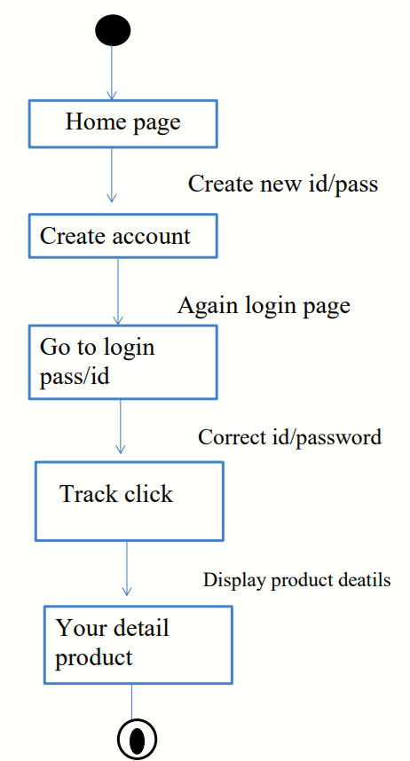
DESIGN
State chart diagram:

Slide 7
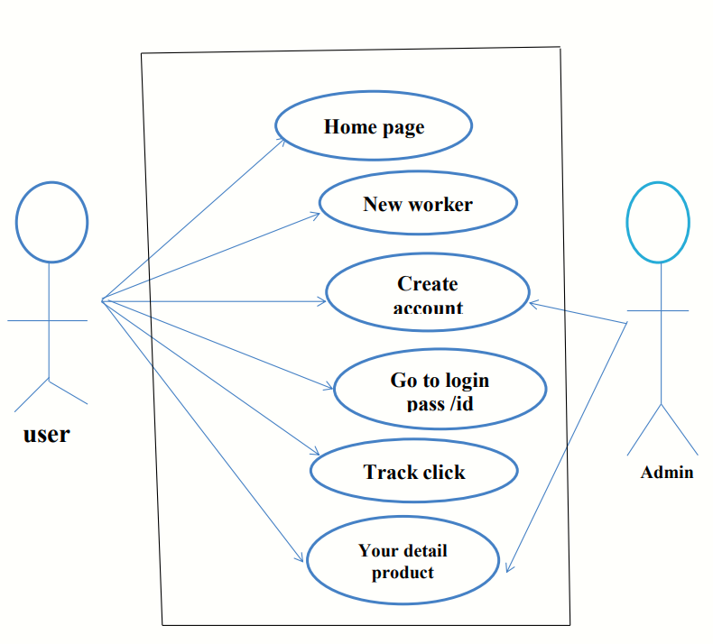
Use case Diagram

Slide 8
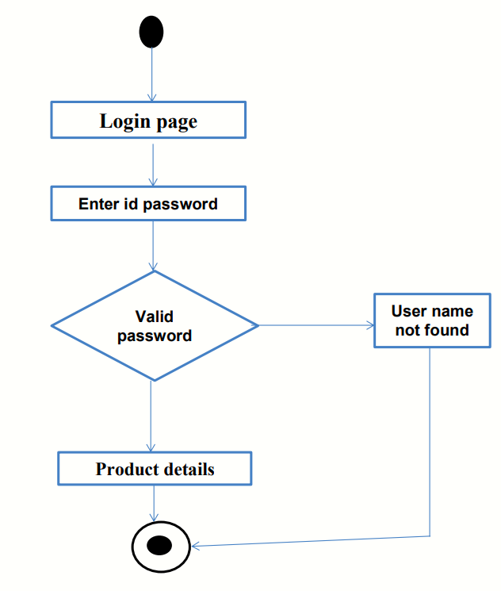
Activity Diagram for courier

Slide 9
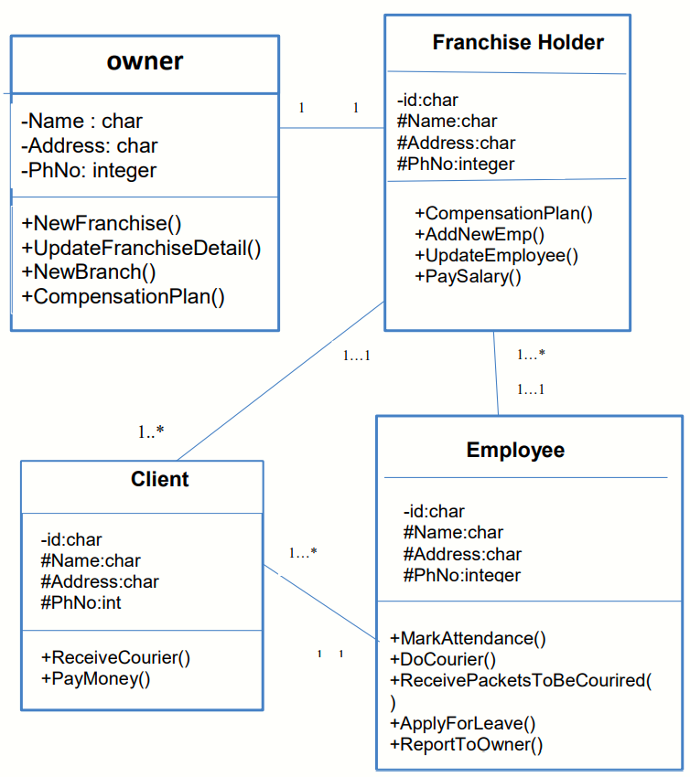
Class Diagram for courier

Slide 10
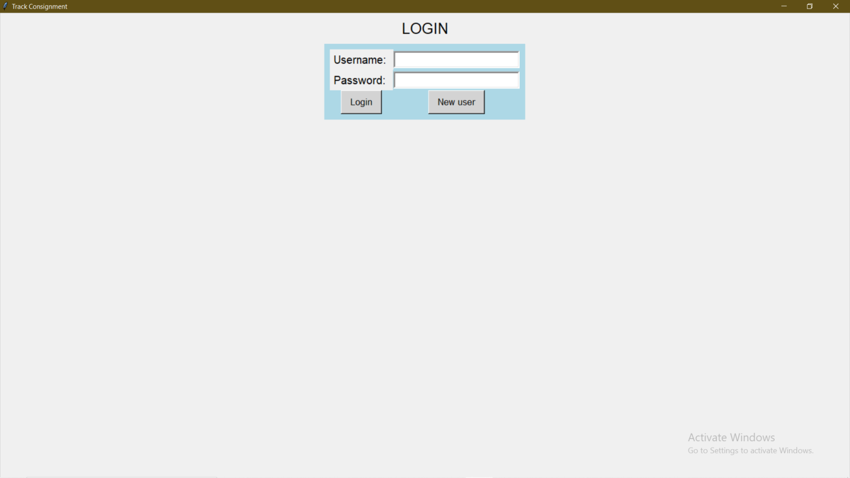
RESULT
PAGEWISE PROJECT SCREENSHOT
1. In this page enter username and password

Slide 11
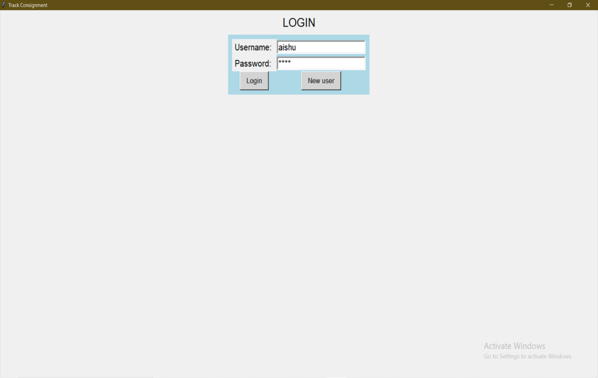
2.To enter username and Password if user name and passwrd are not create so it will be give you error.

Slide 12
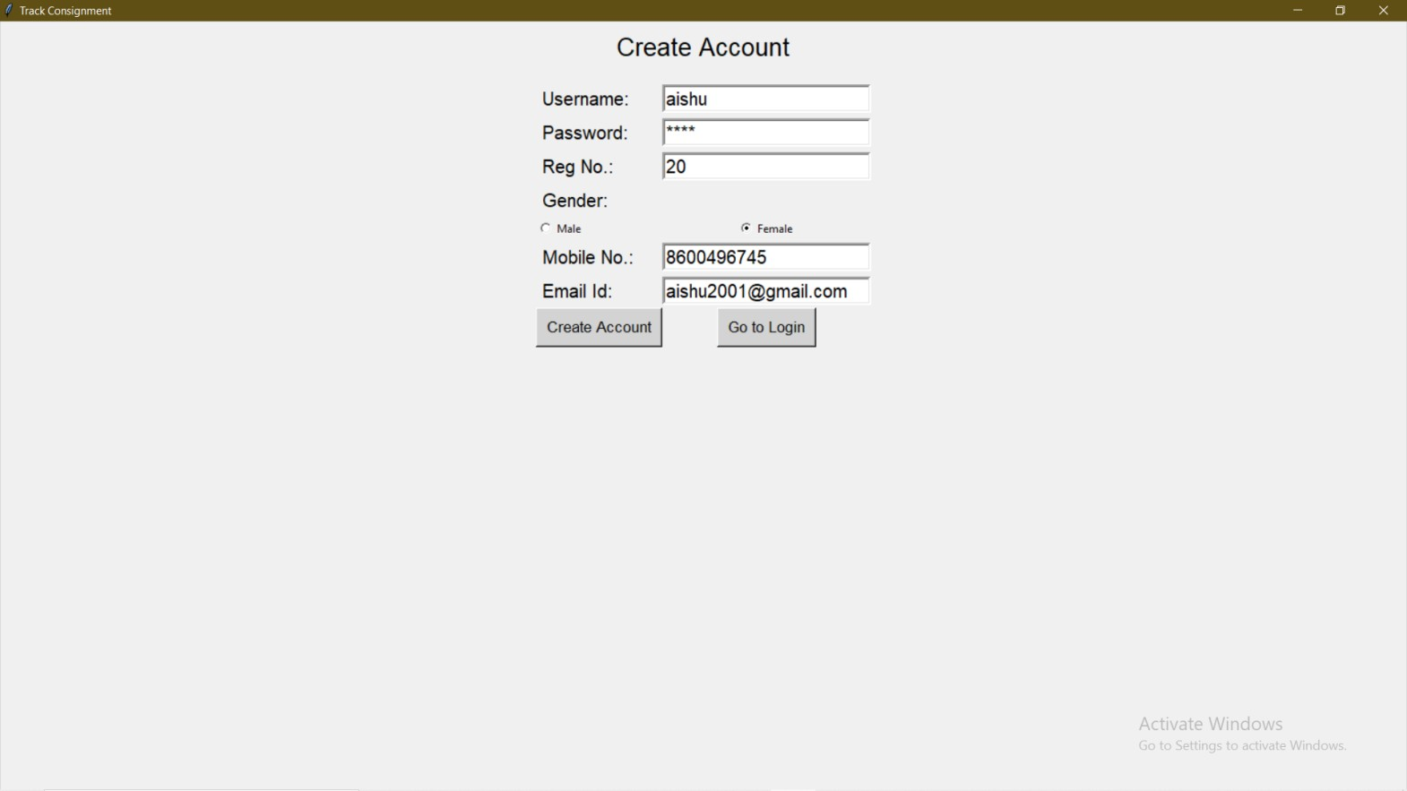
3.In this page we will fill the information for create account.

Slide 13
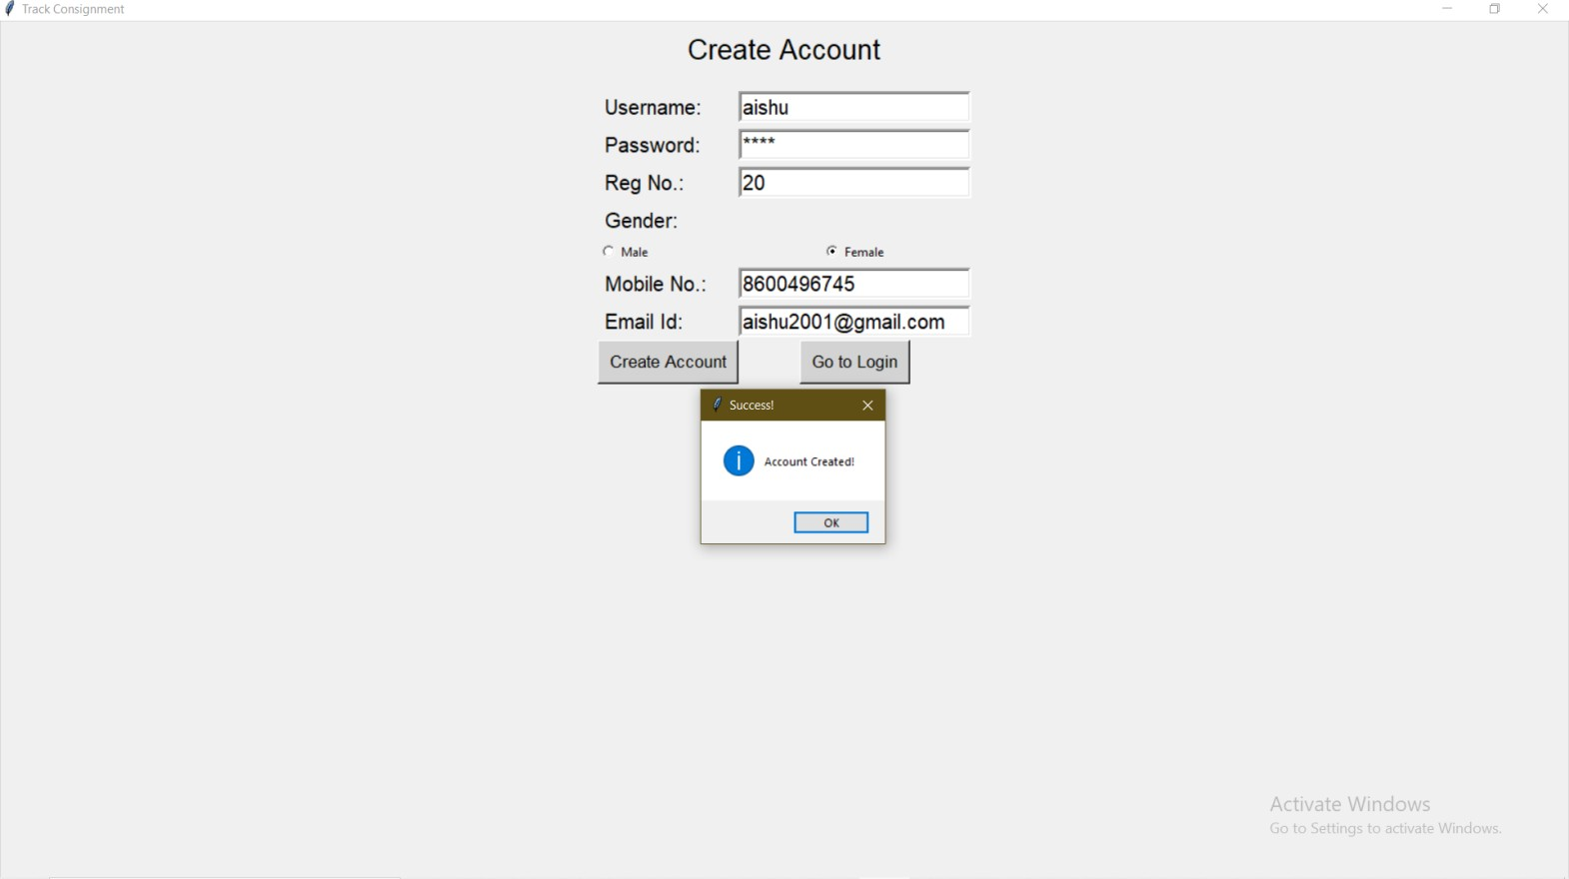
4.In this the page record is created successfully.

Slide 14
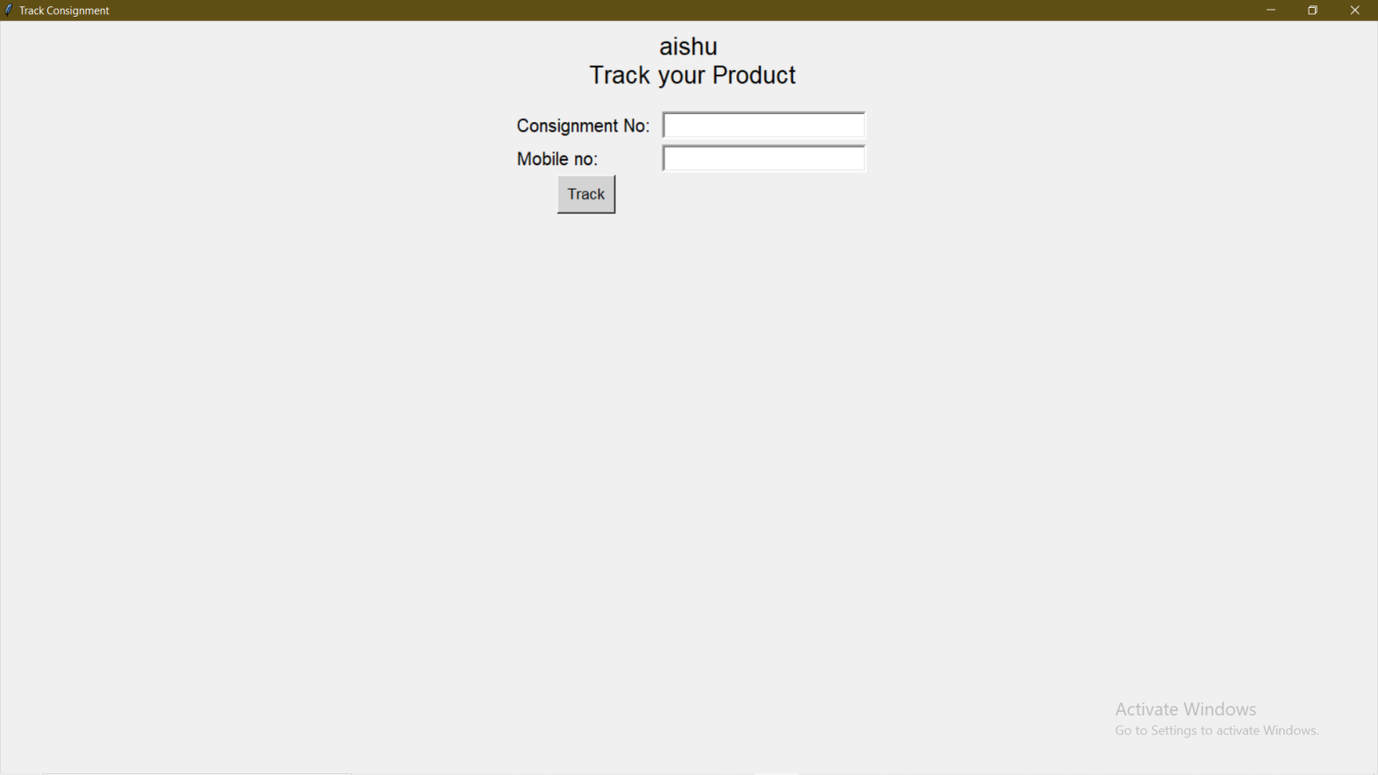
5.In this output screenshot we can track the product.

Slide 15
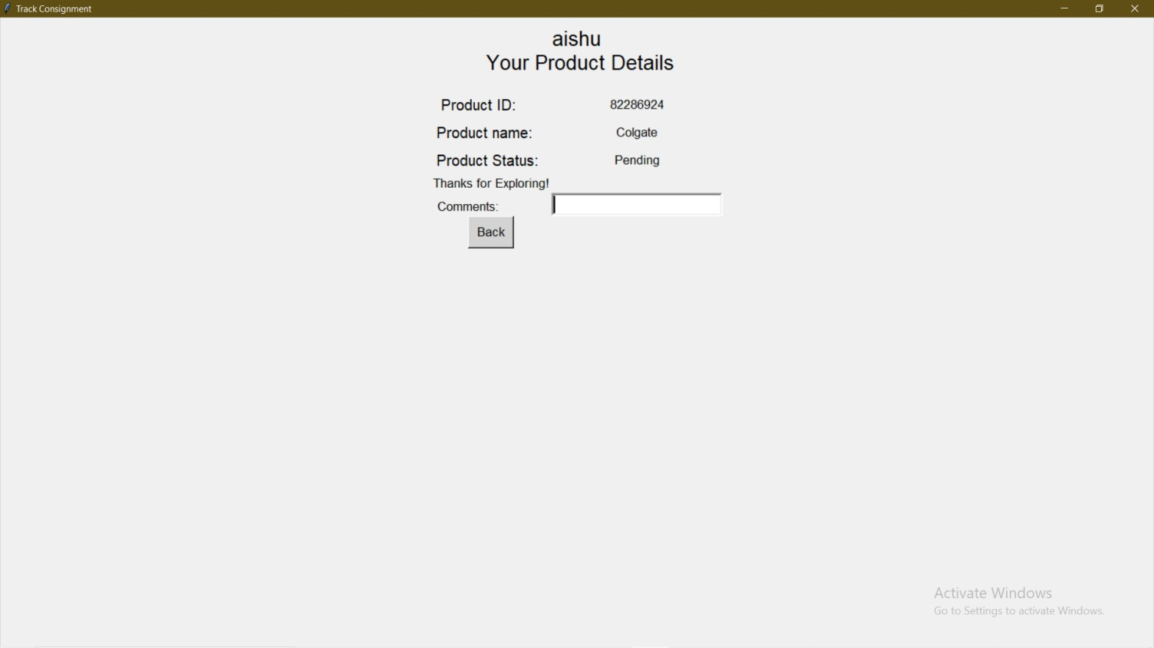
6.In this screenshot we can add the product detail.

Slide 16
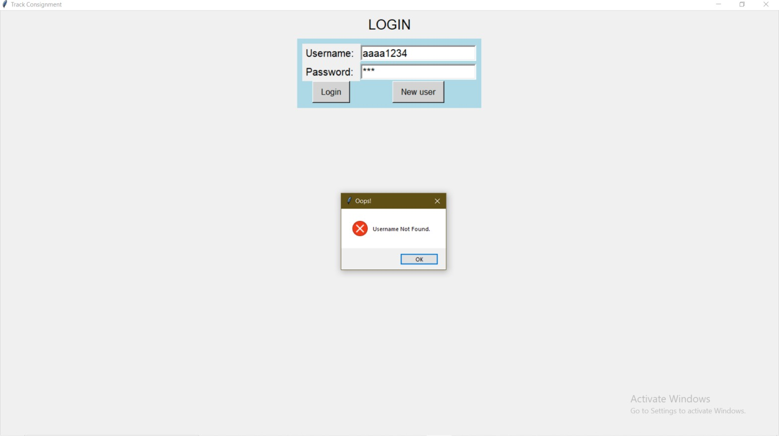
7.Display Error:
This is the output screenshot for display error.

Slide 17
BIBLOGRAPHY
Python:The complete reference
www.google.com
www.youtube.com
www.greeksforgreeks.com

Slide 18
CONCLUSIONS
The courier services are automated as hand written documentation is minimized to a bare minimum the software is fully implemented.
The data can be easily backed up onto a reliable media so that no or minimal data lass is there in case of system crash.
Unauthorized access to the data is nearly eliminated by providing password authentication system.
This project has made us require a professional outlook to wards problem statement and solving it to the best and maximum.
Software testing can be done using techniques like unit test, integration test and performance test.

Slide 19
ANY QUESTIONS..?

Slide 20
THANK YOU..!

